Slide 1


Empowering
PEOPLE
To Engineer
BRILLIANCE

Slide 2
ISO 2626206 - Software Level of Functional Safety

Slide 3
Introduction
This part is about software development for electroonic systems for road vehicles, especiaaly of software used in control units in cars.
When it comes to everything that needs to be considered when developing safety-relevant software, we have to apply part 6.
Road safety not only depends on compliance with traffic regulations, But the vehicles themselves pose a risk to human life if they behave incorrectly.
The more the modern the vehicles become, the more the progress is made towards automated driving.
The safety of vehicles be they cars, trucks or motorcycles, is increasingly dependent on error-free software.

Slide 4
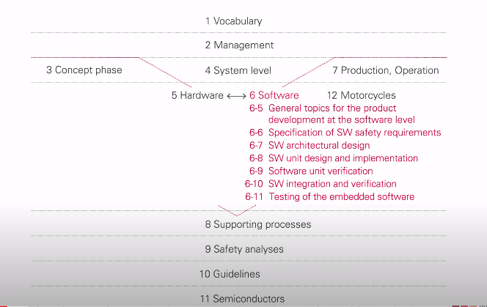
Software development Overview

Slide 5
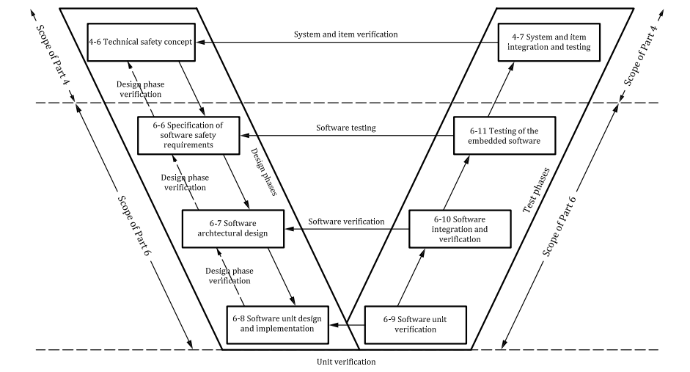
Reference phase model for the software development

Slide 6
Product development at the software level - Key lessons
Safety of vehicles depends more and more on error-free software
Software faults must be avoided through systematic development.
The occurrence of faults must be countered by mechanisms for fault tolerance.
Functional safety requires the software development process to be adapted to the content and requirements of ISO 26262.
Technical FS requirements must be detailed down to quality SW safety requirements.
The SW architecure must implement all functional requirements as well as safety mechanisms.
7. Safety analyses must be performed to understand the dependencies between software components and validate the software design.
8. Software integration and tests must be specified in terms of methodology and carried out successfully.
9. Test coverage must be measured to understand the completeness of tests, and to support the rationale for having achieved test goals

Slide 7
General topics for software development
Suitable software development process
Suitable software development environment
Modelling and coding guidelines
FS is compatible with agile approaches and continuos integration
Configuration and calibration data must be developed like software itself.
Interface with cybersecurity

Slide 8
Part 6 Work products
Safety plan
Software verification plan
Design and coding guidelines for modelling
and programming languages
Software tool application guidelines
Software safety requirements specification
Hardware-software interface specification
Software verification plan
Software verification report
Software architectural design specification
Safety analysis report
Dependent failures analysis report
Software unit design specification
Software unit implementation
Software verification specification
Embedded software

Slide 9
Thank You

Slide 10


We Love Challenges
We Wait To Solve Yours…

